Slide 1
HUNGRY FISH

Slide 2
Project Partners
Mustafizur Rahman (Roll – 22)
Rahat Rizvi Rahman (Roll - 37)

Slide 3
OUTLINES
Objectives
Resources
Construction Process
Logics
Algorithms
Working Process and flow chart
User Friendliness
Our Experience

Slide 4
Objective
To Understand the practical use of C/C++ programming Language.
To make a step towards creating animations , working with graphics and to develop ideas about game development.
To visualize graphical user interface.

Slide 5
Resources
Used Code Blocks 16.01 version
Used Borland Graphics Interface(BGI)
Used Images Only for making co – relational interface with the users.
C/C++ learning sources.

Slide 6
Game Features
Resolution 1600 * 700
A Two Dimensional Game.
Game is totally visualized from “Side VIEW” .
Basically a fish game with having various attractive features.
Used different images for different purposes.

Slide 7
Game outline
User needs to control a large hungry fish. It will move towards various directions to eat small fishes coming randomly . Eating more fish will give more score.
There will be lots of poisonous fishes. Getting closer to this fish will reduce the life hungry fish.

Slide 8
Game levels
Easy-Least number of poisonous fishes will appear
Medium-Opportunities and risks are more than Easy level
Hard-Maximum number of poisonous fishes will appear

Slide 9
Fishes
Drawn by using BGI built in functions line, rectangle , fillpoly ,floodfill , setcolor ,circle,arc etc.
Geometrical Proper relation in the making format.
Can move
Color – Yellow, Red, Light Blue, Green, White, Black ,etc.

Slide 10
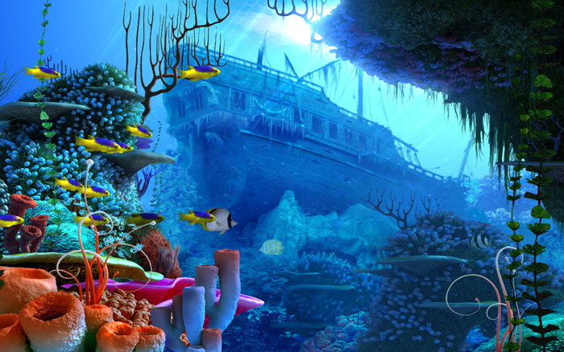
Image of The background

Slide 11
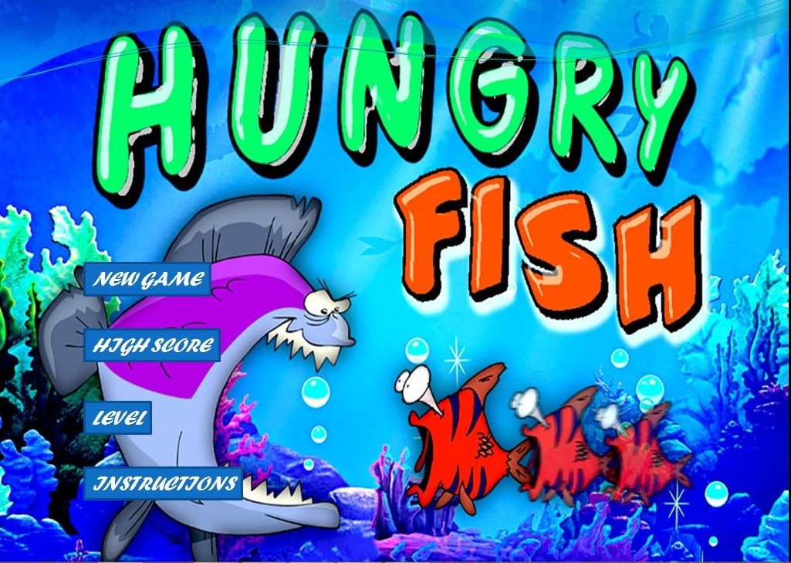
Main menu

Slide 12



Image of Hungry fish , small fish, poisonous fish
HUNGRY FISH
SMALL FISH
POISONOUS FISH

Slide 13
LOGICS

Slide 14
MOVEMENT OF FISHES
Two Types
1.Random - Small and Poisonous fishes
2.User controlled – User will determine the movement of the hungry fish.
3.Efficient Movement
4.Sycronizing perfect, controlled precisely
5.Fastest,swiftest,smooth Move.

Slide 15
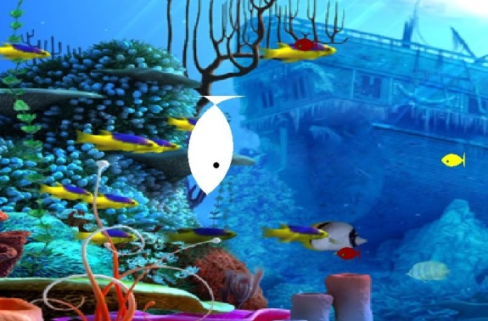
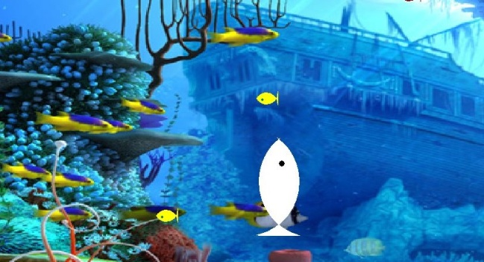
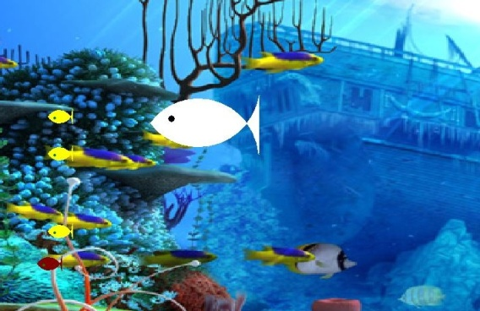
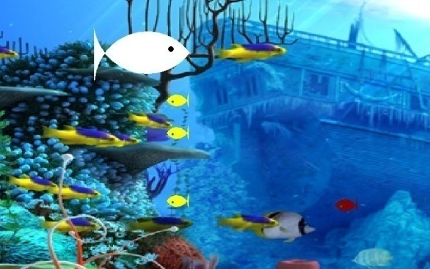
FISH Movements

Slide 16
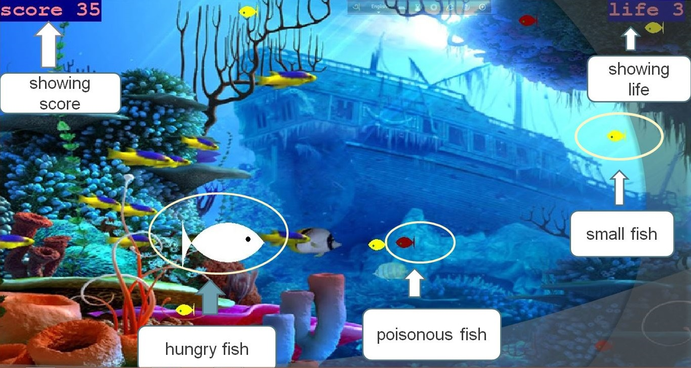
SHOWING POSITIONS OF THE OBJECTS

Slide 17
Collision Detection (CAR)
Mathematical Logics –
We defined a collision hungry fish and small fish if the distance from mouth to center of hungry fish to small fish is less then or equal to the radii of small fish.
We defined a collision hungry fish and poisonous fish if the distance from center to center of hungry fish to small fish is less then or equal to the summation of radii of both fishes.
The following equation was used to measure the distance from one center to another,
(x1-x2)^2+(y1-y2)^2<=r^2
here (x1,y1) is the coordinate of one point and ( x2,y2) is the coordinate of another point and r is the maximum total radius.

Slide 18
Working Procedure OF HUNGRY FISH

Slide 19
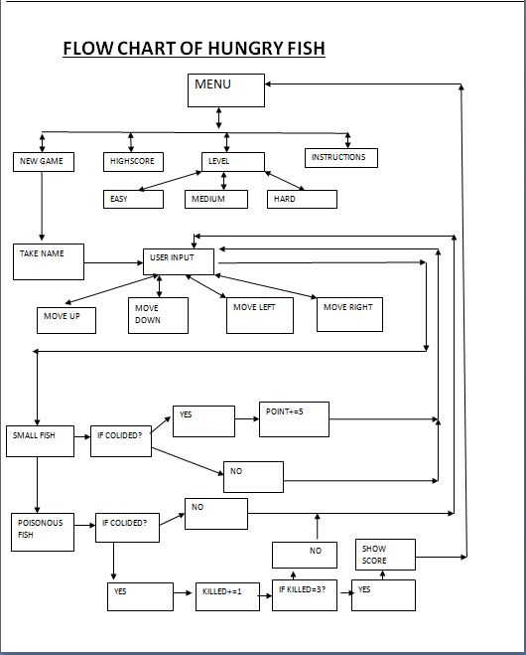

Slide 20
User Friendly
Attractive menu option
User’s choice can be taken on level selection
Both Keypad and mouse control options are used
Instruction List’s been added.
Developed High score

Slide 21

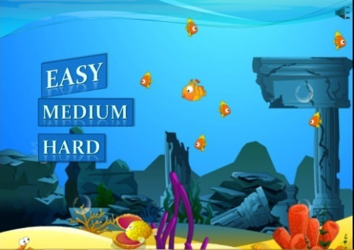
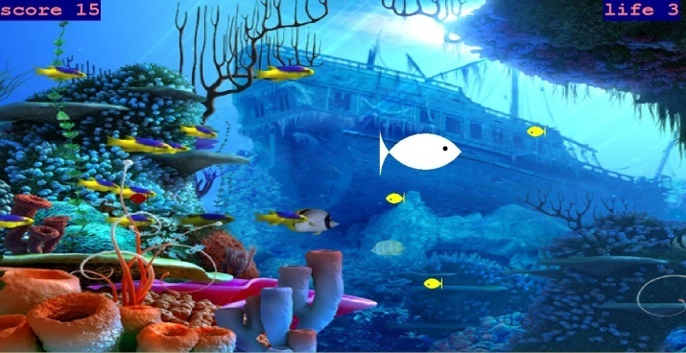
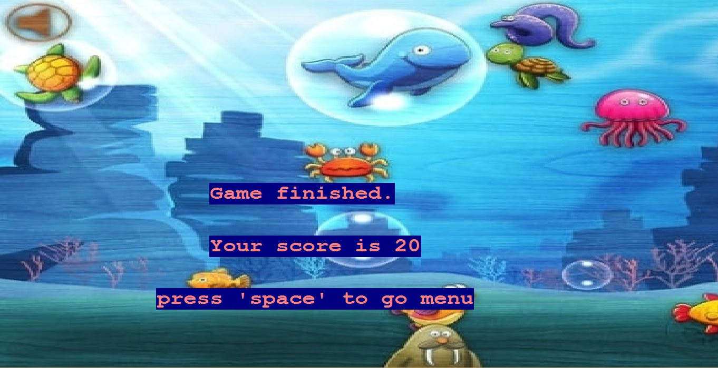
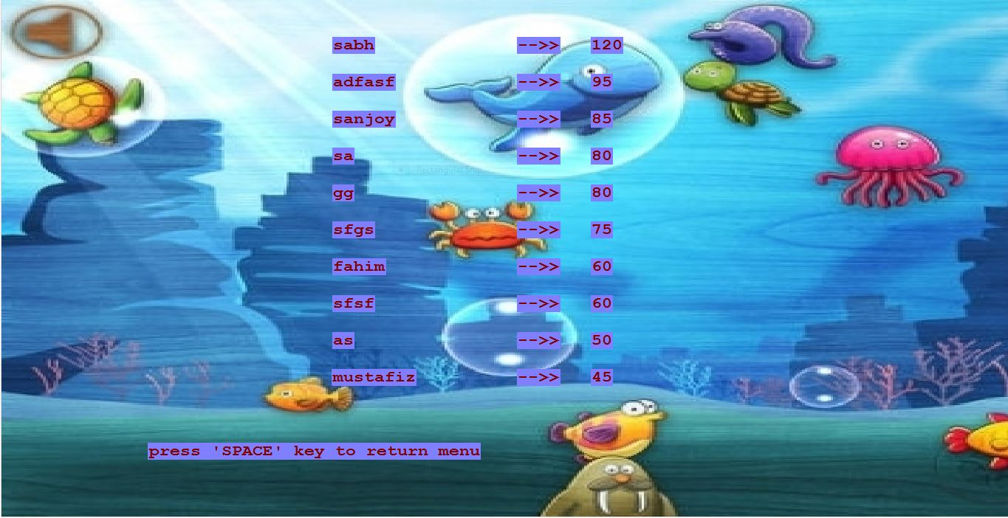

Slide 22
Our Experience
Working in a project like making a game was really very interesting and we gained much knowledge while building it. Most importantly we developed our structured programming knowledge and as our code was about 3000+ lines, this was the first time we wrote such a big code and really was very helpful.
But we faced some problems in BGI . In BGI, we faced problem in controlling buffer input and most importantly, the execution of function is BGI is really slow. This really problemed us.

Slide 23
Thank You

